Slide 1
SAP BTP CLD200 Overview
Day 1
Anubhav Oberoy
www.AnubhavTrainings.com
Follow excellence with sheer passion

Slide 2


INTRODUCTION

Slide 3

Introduction
Welcome to the BTP Architect Training Course, specially designed for senior SAP Consultants planning to provide guidance on SAP BTP Adoption
The Course is designed to provide end to end development on SAP Business Technology platform, Deployment, lifecycle and security overview with Hands-on
Notes:
https://pixabay.com/photos/architecture-building-amsterdam-1448221/

Slide 4
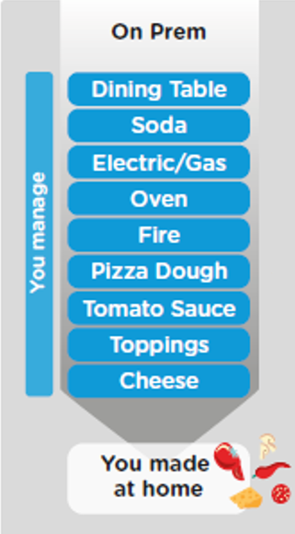
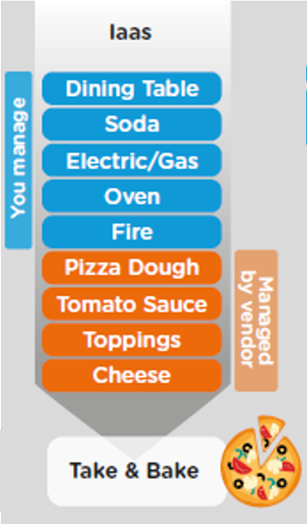
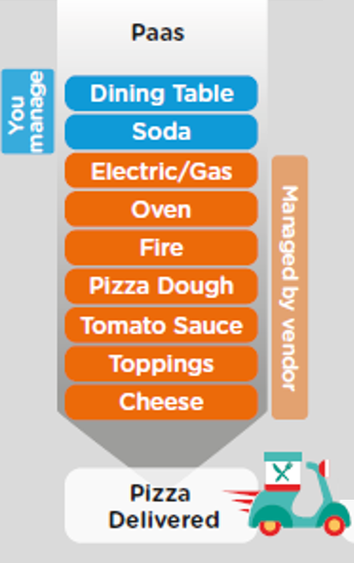
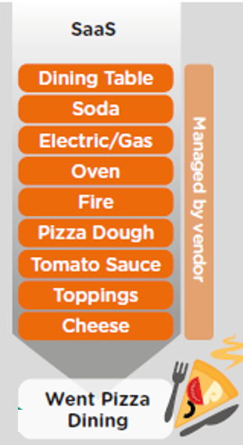
On-premise v/s Cloud Systems

Slide 5




What is SAP CLOUD FOUNDRY?
Application
Application
Data
Data
Runtime
Platform as a Service
Managed by SAP implementing open source CF
Middleware
Fully ready landscape with reusable services
Scalability
Elasticity
Low TCO
Database
OS
Managed by Infrastructure
providers
Data Centers
Service Portfolio
Virtualization
Infrastructure as a Service
Servers
Storage
Networking

Slide 6
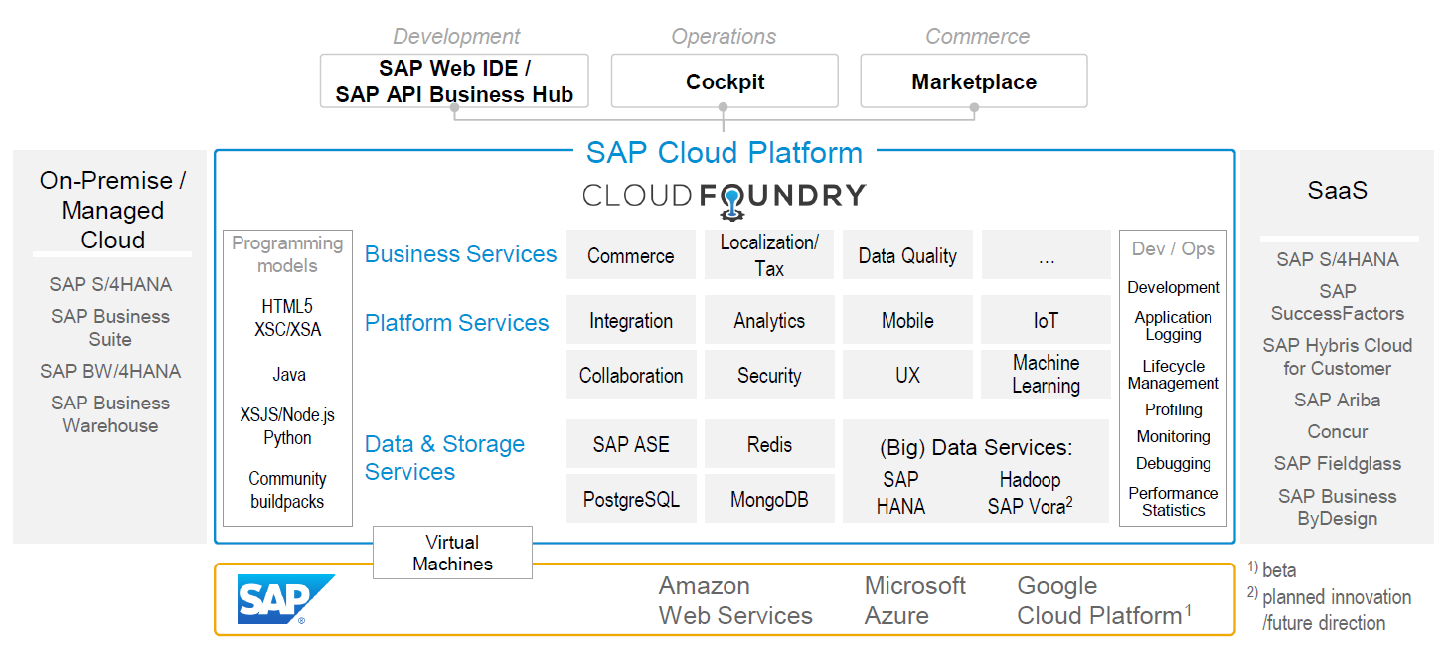
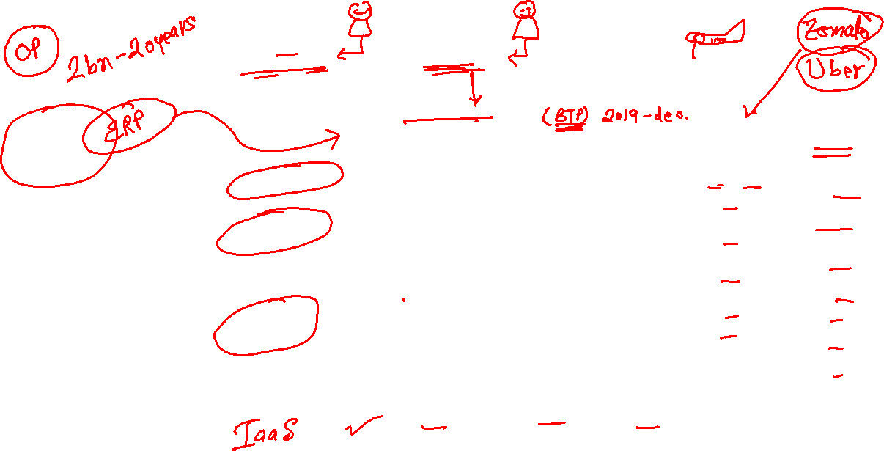
SAP Cloud Foundry Architecture
SAP Business Application Studio

Slide 7
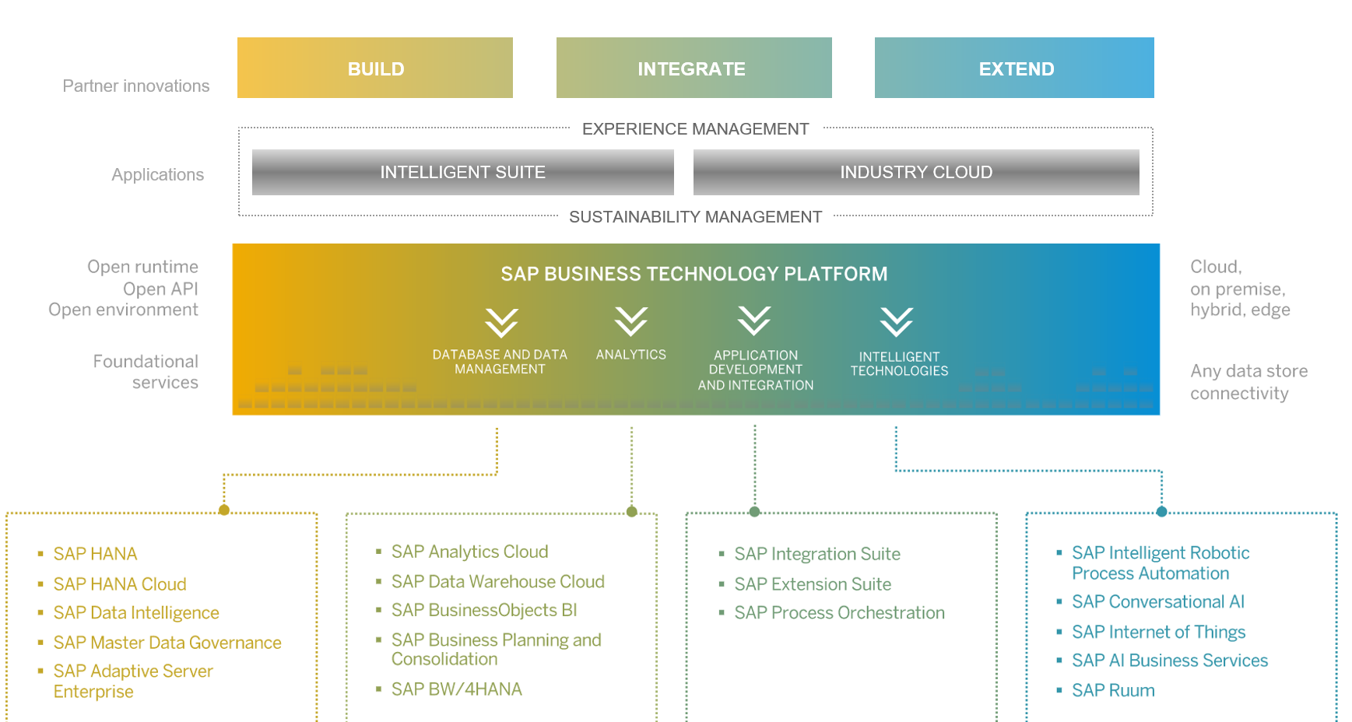
SAP BTP Architecture

Slide 8
Org Structure BTP CF
Directories
Additional grouping of subaccount to manage policies easily
Global Account
(Representation of a customer – used for billing purpose)
e.g. IBM, EY, Nvidia
Entitlements – Services which this customer opted for
5 – HANA
100 – CF Runtime
Sub Account
Per Region, Datacenter, IaaS
(Organization by the customer, how they want to split their services and development teams)
S1 – EU (2), S2 – SG, S3 – US(3)
Space
(It is the compute unit in which we actually deploy and run our application – it constructs our landscape for development)
DEV | QLT | PROD
Assigned with Quota
Sub Account
Per Region, Datacenter, IaaS
(Organization by the customer, how they want to split their services and development teams)
S1 – EU (2), S2 – SG, S3 – US(3)
Sub Account
Per Region, Datacenter, IaaS
(Organization by the customer, how they want to split their services and development teams)
S1 – EU (2), S2 – SG, S3 – US(3)
1..*
1..*
Here we assign entitlements which we got from global account to sub accounts to organize what is really needed at each sub account level
1..*
Apps
Apps
Apps

Slide 9
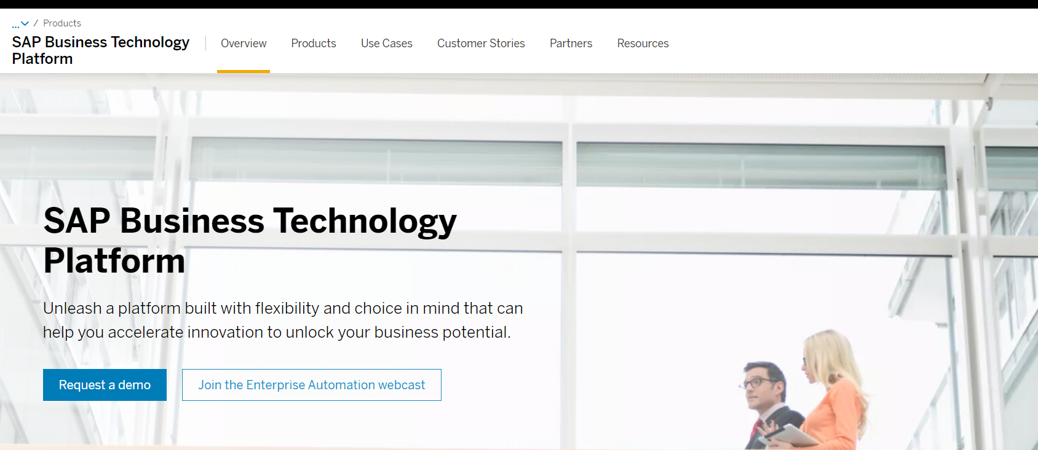
Setting up SAP BTP Account
Notes:
https://account.hanatrial.ondemand.com/trial/#/home/trial

Slide 10
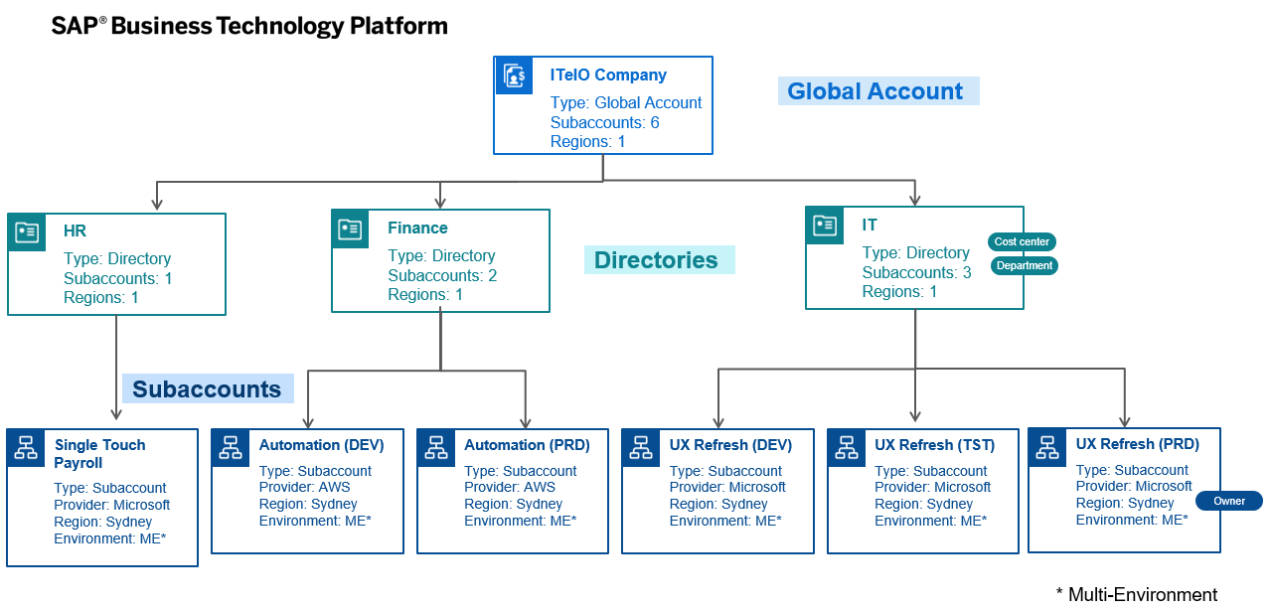
BTP Account Structure
space
space
space
space
space
space
space
space
space
space
space
space
space
Notes:
Directories allow you to group related subaccounts and create a hierarchy. With the recent update, you can have upto 5 levels of nested directories. Directories are entities which have been introduced with Feature Set B. So why would one need to use them:
Enables you to group subaccounts based on different department, Lines-of-Business, Geography, Subsidiaries etc. For example, there could be a department that has funding and want to have more control on the application or interface deployed on SAP BTP subaccount, this structure would help in providing the relevant access to the department staff
Filter based on custom properties/tags. You can create custom properties against each of the directory to search for all the relevant entities. The subaccounts under a directory inherit these custom properties and tags.
Monitor usage & cost at directory level. For example, each department will have full visibility of the usage and cost associated with their apps. This can help in 3rd party billing as well as cost chargebacks.
Allocate Service entitlement and quotas. You can allocate quota for services to the directory from the global account quota for distribution to the directory’s subaccounts.
Similar to the Global account, you can also add users at directory level to manage directory entitlements (Directory Admin, Directory Viewer)
Subaccounts are the lowest entities in the hierarchy. Its at the subaccount level, where you will be deploying your apps, databases and interfaces. Subaccounts are regions specific – meaning you can decide in which country you want to setup your subaccount environment. All the service entitlement & quotas which have been purchased and allocated via the Global Account/Directories will be consumed within these subaccounts. You also have an option to add additional custom properties/tag at the subaccount level to make it easy to search and report on them. As a subaccount administrator, you will be able to add your developers/admins to the subaccount to support with the required tasks.

Slide 11
Environments, Subs, and services
Environments
Environments constitute the actual platform-as-a-service offering of SAP BTP that allows for the development and administration of business applications. Environments are anchored in SAP BTP on subaccount level.
SAP BTP offers three environments: ABAP, Cloud Foundry and Kyma. Some existing customers still have Neo, but this is no longer offered.
Subscription based services
You will also see these ones called software as a service (SaaS), or multitenant applications. The experience here is that you subscribe to the service, and in return you receive a URL, from which you can access that service. Opening the URL brings you to a web application from which you can leverage the service. This is how other SaaS like SuccessFactors or S/4HANA Cloud work as well. They are also enabled at a subaccount level, and are independent of the environments. You don’t need to have Cloud Foundry enabled to subscribe to SAP Launchpad Service, for example.
Examples include Launchpad, SAP Business Application Studio, Cloud Integration, Process Automation…
Instance based services
These are the purest services. They provide a specific functionality, like databases, connectivity, authentication…. You connect your application to them to leverage that functionality. These services don’t provide a UI to manage them. Instead, they rely on API to connect to applications and other services and provide their services. They are provisioned inside an environment, so they are environment specific. Each environment has its own organization (for users and applications): In Cloud Foundry, instances are created inside a space. For Kyma, instances are created inside a namespace.

Slide 12
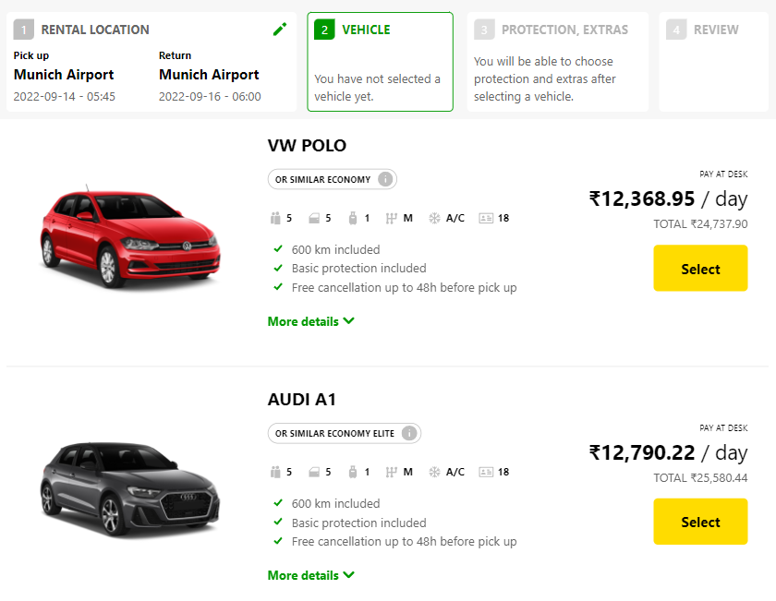
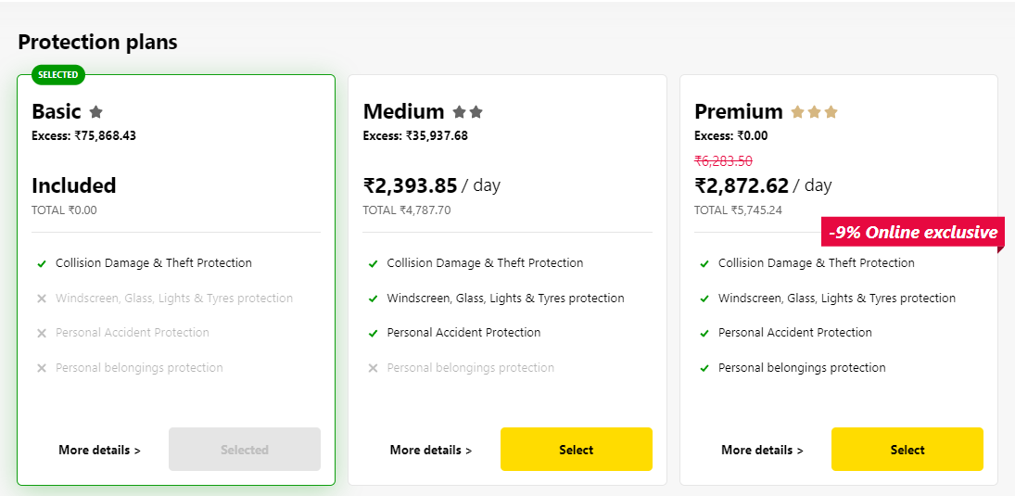
Backing Services in BTP
Each service has one or more service plans available. A service plan is the representation of the costs and benefits for a given variant of a particular service. For instance, a database may be configured with various "T-shirt sizes", each of which is a different service plan.
Choose Your service
Backing Service
Select Plan
Service Plan

Slide 13


Service instance
Car key to use Car
Service Key to Consume Service instance
Actual Car
Service Instance

Slide 14
Service Catalog & Entitlements
The SAP Discovery Center is a relatively new site hosted by SAP for developers and architects to find the services hosted by sap in SAP BTP and their respective service plans available.
It will also help technical team to identify the data center availability and cost associated with each service.
https://discovery-center.cloud.sap/#/serviceCatalog
Entitlements are the heart of all subaccounts in SAP BTP. They define which service and runtime artifacts you are able to use. When you purchase an enterprise account, you’re entitled to use a specific set of resources, such as the amount of memory that can be allocated to your applications.
An entitlement is your right to provision and consume a resource. In other words, entitlements are the service plans that you're entitled to use.
A quota represents the numeric quantity that defines the maximum allowed consumption of a resource. In other words, how much of a service plan you're entitled to use.
Entitlements and quotas are purchased and managed at global account level, from where they’re distributed to subaccounts, which consume them.
When you remove quotas or entitlements from a subaccount, they become available again at global account level and can be assigned to other subaccounts.

Slide 15
Quota Plans
In the Cloud Foundry environment, you can further distribute the quotas that are allocated to a subaccount. This is done by creating space quota plans and assigning them to the spaces.
Space quota plans are optional and are used to limit how much each space can use, not to enable. If you don't create any space quota plans, all spaces in a subaccount using the Cloud Foundry environment have access to all entitlements and quotas in that subaccount. This means that one space could use up all the quota in a subaccount.
If you want to prevent that from happening and set a limit to how much each space can use from the total quota available in the subaccount, you can use quota plans and assign them to spaces.

Slide 16





























BTP Use Cases – Build New Applications

Slide 17
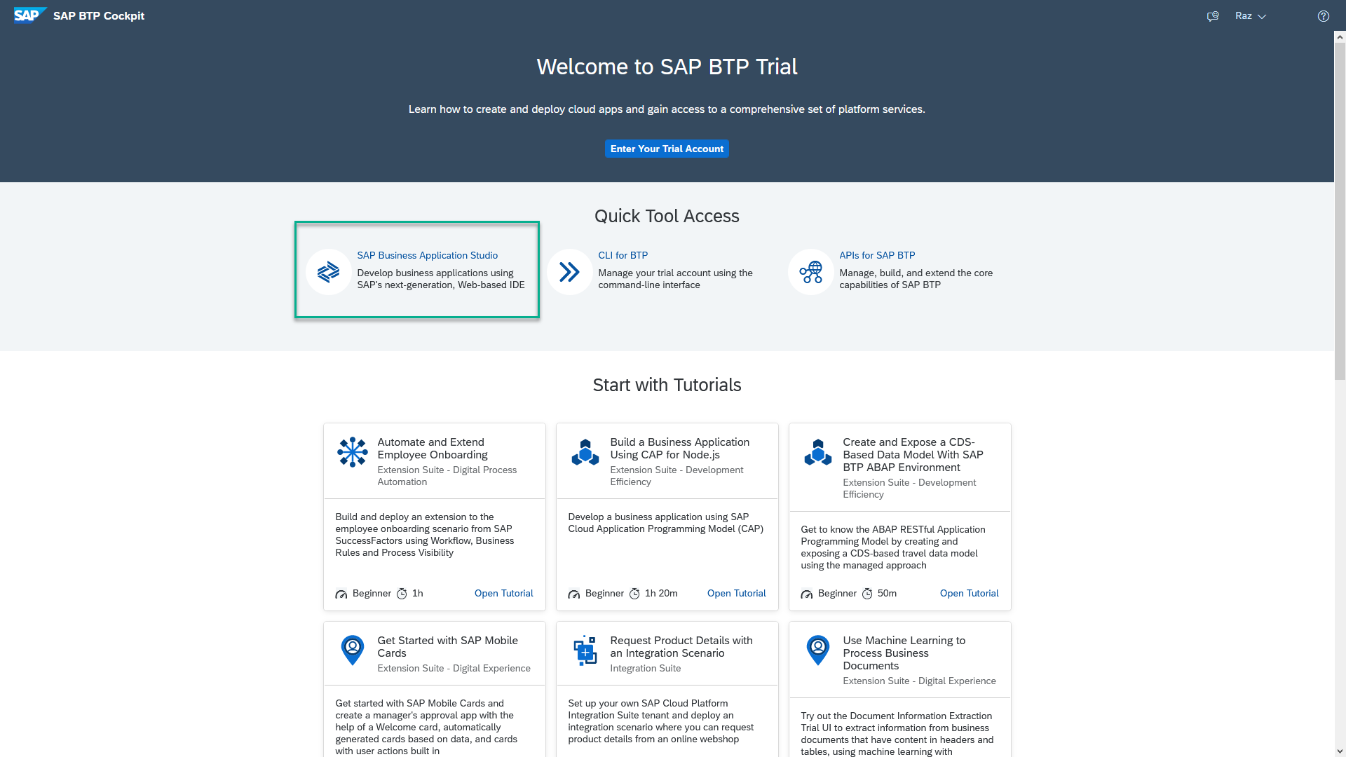
Business Application Studio
SAP Business Application Studio is a development environment available on SAP Business Technology Platform. Before you can start developing using SAP Business Application Studio, administrators must perform the required onboarding steps that are described in this tutorial.
In an Enterprise Account you can set up SAP Business Application Studio as a Free-Tier service by checking its free plan during its entitlement configuration.

Slide 18
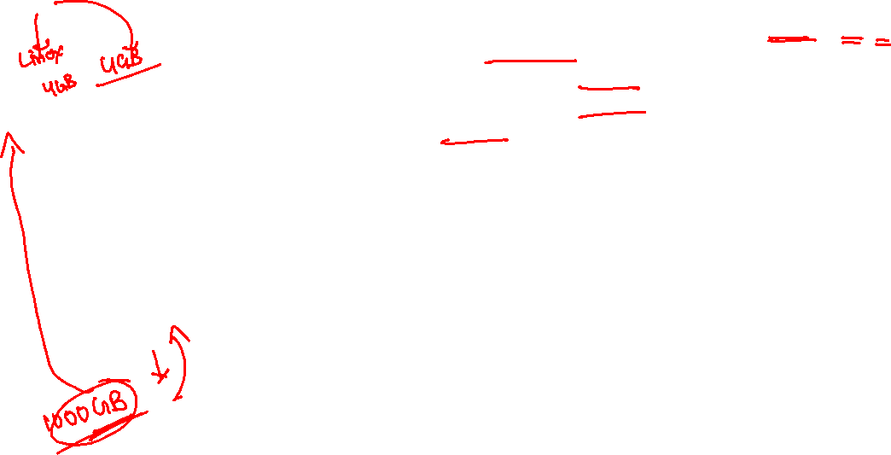
Dev Space in BAS
We don’t want a single developer to consume all the available resources
We want a clear isolation of one developer with another
Pre-configured by sap for specific development
Solution - Virtualize
Dev Space
Dev Space
Dev Space
SAP BAS – Business App Studio
SAP BTP – Platform as a Service
IaaS – Infrastructure as a Service

Slide 19
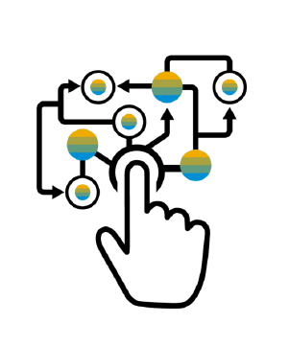
Micro Service Architecture
Characteristics of the traditional model
SAP systems are one large logical system with a single (SQL) DB
Transactional consistency for all data is guaranteed
Big, infrequent releases with high risk
Hard to apply cloud requirements
Monolith must be built, tested, deployed, and scaled as a whole
Vertical scaling* is limited, cost is non-linear
Systems often poorly utilized (dev-test, non-peak-times)
High availability setup requires almost double the infrastructure
“Microservice architecture is an approach to developing a single application as a suite of small services, each running in its own process and communicating with lightweight mechanisms, often an HTTP REST API. These services are built around business capabilities and independently deployable by fully automated deployment machinery.”

Slide 20
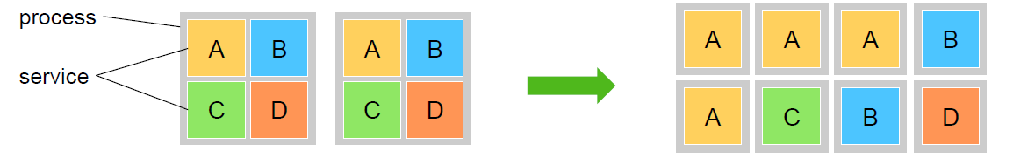
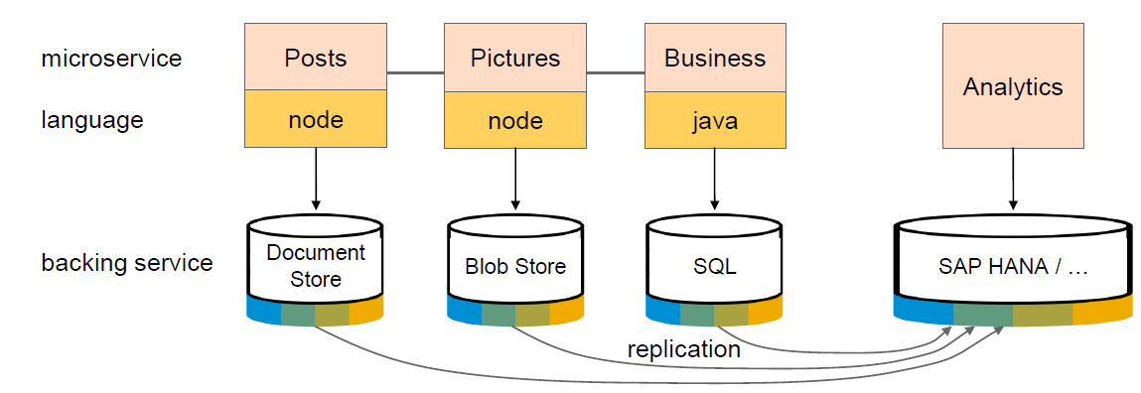
Advantage of Microservices
Each microservice runs in a separate process / container.
This enables them to
Be deployed individually and frequently
(Auto)scale independently to varying loads
You can use technologies and languages that best fit the problem *
Microservices are self-contained, i.e. no shared data stores (!)
Using the right tools impacts productivity and performance

Slide 21
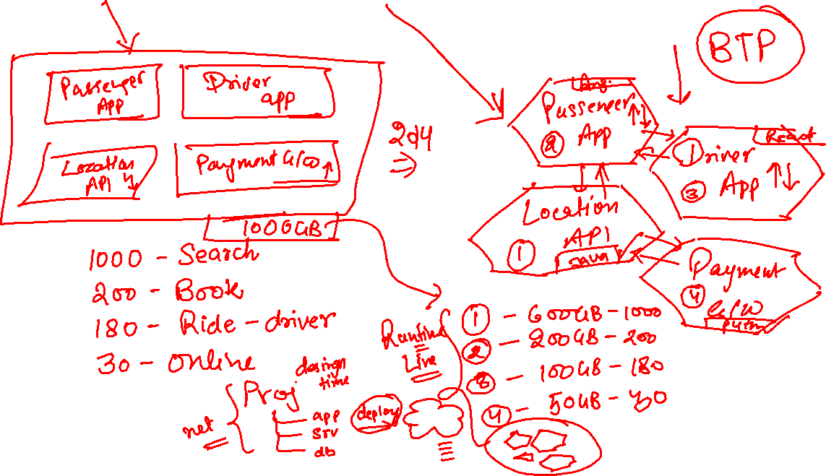
Monolithic VS Microservice (Ex: Uber)

Slide 22















































Slide 23
CAPM Introduction
CAPM is a framework of (a framework is a collection of libraries, classes, function, attributes, events)
Languages – Java and Node JS
Libraries – Node modules like cds, cds-dk etc.
And Tools – VS Code or BAS
The framework can be used to build native cloud applications:
Full stack applications → database, application layer, service layer and UI layer (Presentation layer)
Extend existing application → Side by Side extensibility using S/4HANA cloud SDK

Slide 24









































Slide 25


































Slide 26
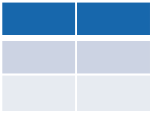
Challenges of building DB
Many times developers end up using a technology which is tightly coupled to DB. Which means when we change database, we have to re-write our entire application again.
Developer
If I have written 2mn SQL statements in our application, we end up re-writing all these statements again just to change database technology.
What we want?
To develop application in a way that we should not couple our app code tightly with DB. We want to develop in DB agnostic manner.
CREATE TABLE tab COLUMNS c1 int, c2 char;
CREATE TABLE tab COLUMNS
c1 : integer;
c2 : varchar length 30;
SQL Server
Oracle DB

Slide 27







CDS – Core Data and Services
CDS is a concept which allows us to get rid of SQL. It is an extension of SQL (what SQL can do, cds can also do). We need to create a design time artefact with an extension called .cds for almost everything e.g. database objects, services, Ui's. the CAPM framework will compile this file and generate the necessary statements and artefacts. CAP framework comes with a library called @sap/cds which is responsible for the compilation of cds artefacts. In order to use this library we need to install it at project level. CAPM also comes with the required tooling to generate your project skeleton, that is also comes with a library called @sap/cds-dk.
.cds
Design time artefact
@sap/cds
Runtime artifacts generated as per database

Slide 28
Solution – use CAP framework
entity tab{
c1 number,
c2 string(20)
};
https://cap.cloud.sap/
Design time artefact
.cds
CAPM Framework
SQLite
@sap/cds
CDS Engine
HANA
SQL Code
Database Agnostic

Slide 29
Hands on: Modules for using CAP
We need to install sap cds-dk (Development kit), This kit includes required framework libraries and source code to build, test, deploy, run cap applications. It comes along with cds CLI which will be used by developers to quickly generate the cap project skeleton. This module needs to be installed globally in our system if we are using VS Code, in case we use BAS, this module is pre-installed.
npm install -g @sap/cds-dk
node version >= 14
Check if the CAP is installed in my system ➔ cds –v & cds --help
Create a folder in our computer, and run cds init command. This will create a project skeleton automatically which includes db, srv, ui folders.
If you want to quickly manage multiple node versions in your computer you can use nvm tool - https://github.com/coreybutler/nvm-windows/releases
When we make constant changes to the project, we want project to detect a correction and automatically restart the server. We can use the cds watch command instead of cds run

Slide 30
DB Design
Addresses
1..1
Business partner
(Customers, Suppliers)
1..*
Purchase order
Product Text
(localized)
1..*
1..*
Purchase order Items
1..1
Product

Slide 31
Association v/s Composition
Association – a relationship between entities which is a lose coupling. Both objects should exist together. However, they can work independently. Airplane and passenger.
Composition – a relationship between entities which is a tight coupling. Both objects must exist together. They cannot function independently. Airplane and wings.
Purchase Order Header
composition
Purchase order Items

Slide 32
Generic Handlers in CAP
The CAPM framework generates most of the code to perform CURDQ operations on the entity. It does not know what validations to perform on our business data. As a developer, when we want to attach a pre-check (validations) / post-check (post processing code) on an entity operation, we can use generic handlers. All these operations are performed SYNCHRONOUSLY.
At times we want to
Take full control of our implementation
We want to add some validation before data is inserted or updated
We want to change data before insert/update
Read some extra information while GET calls
Fiori app
odata
cap
Generic handlers
database
before
on
after

Slide 33
Lunch Break

Slide 34
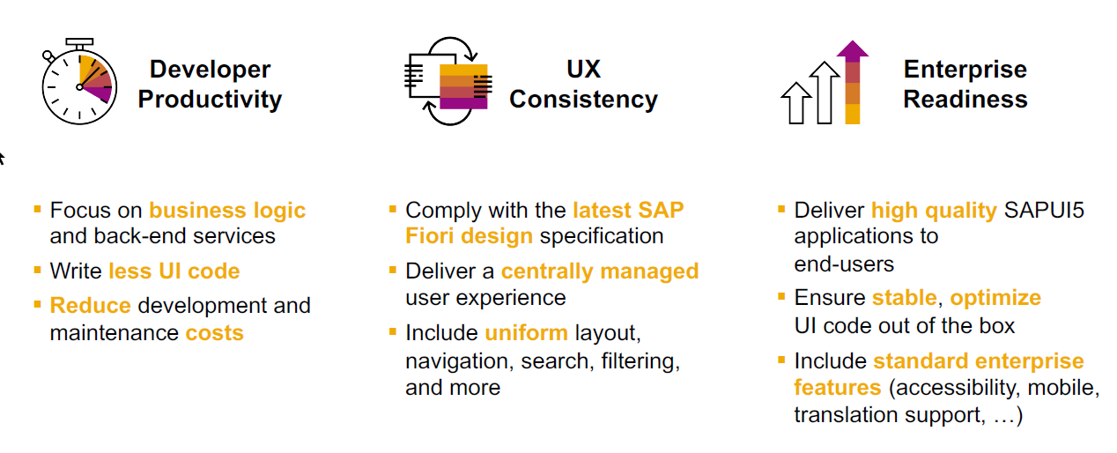
SAP Fiori elements boosts SAP Fiori development efficiency

Slide 35
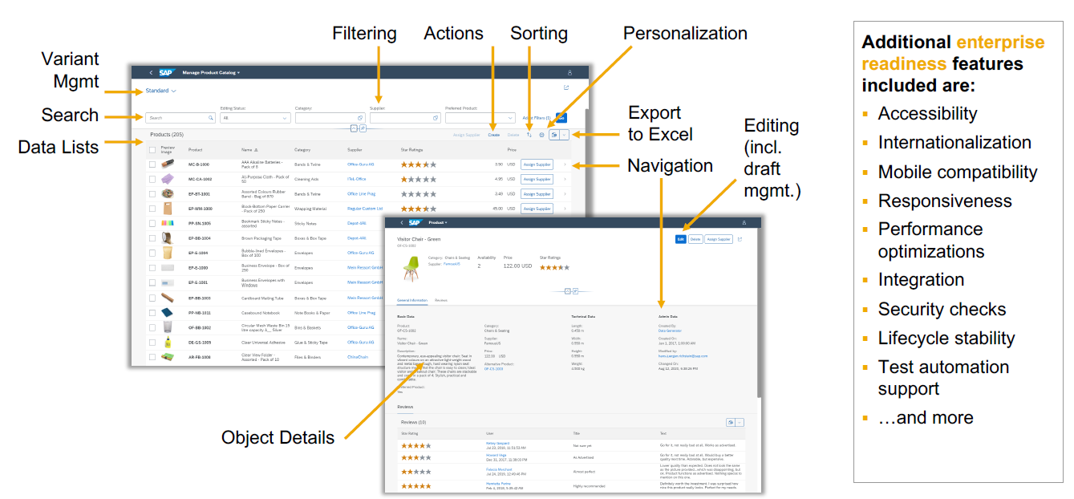
SAP Fiori elements provides enterprise-ready apps out of the box

Slide 36
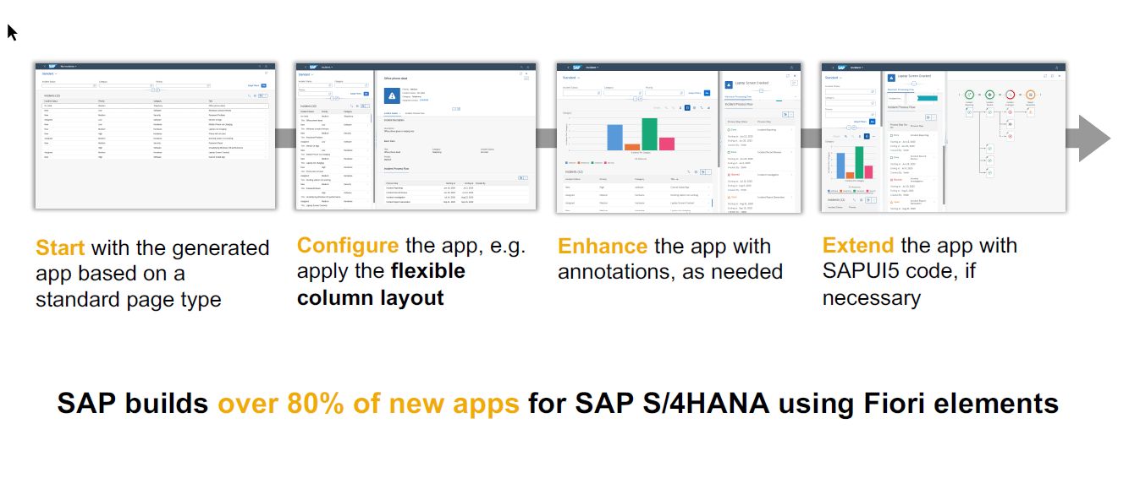
SAP Fiori elements application architecture provides flexibility

Slide 37

SAP Fiori elements prioritizes efficiency over flexibility

Slide 38
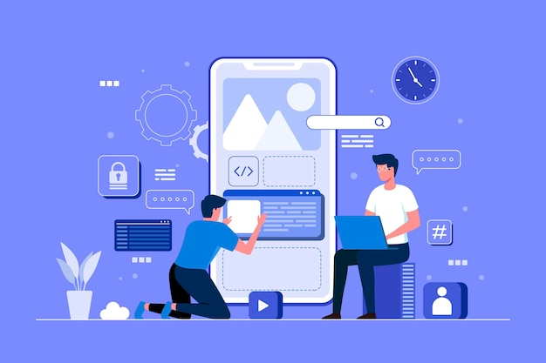
Hands on : Fiori App

Slide 39
Draft Functionality

Slide 40
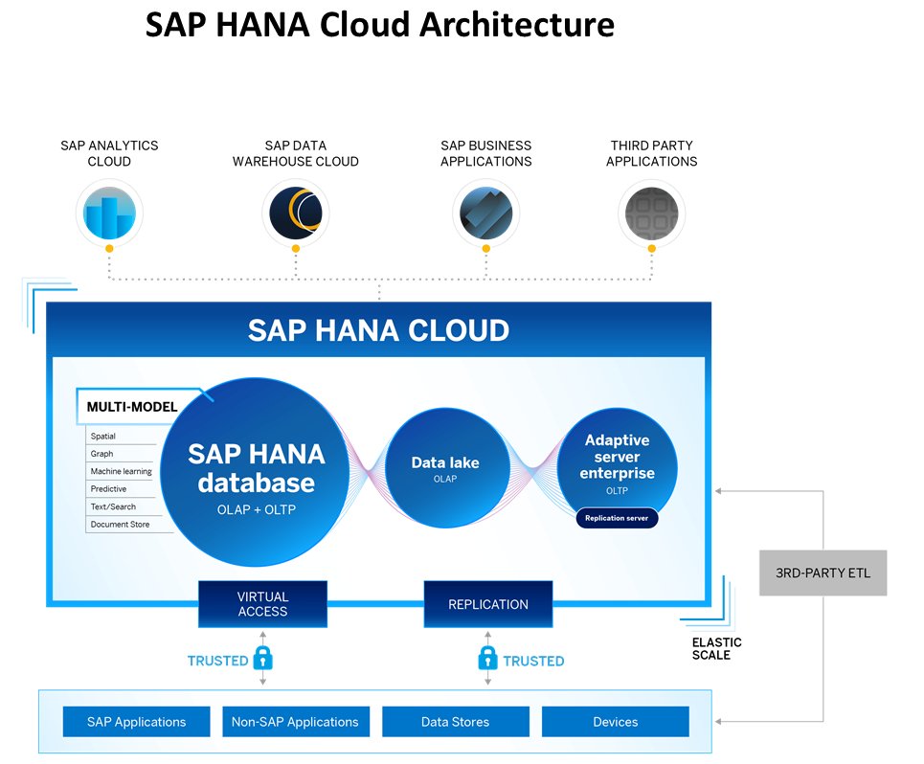
Introduction to HANA Cloud
SAP HANA Cloud is a fully managed, in-memory, cloud database as a service (DBaaS). It is the cloud-based data foundation for SAP Business Technology Platform. With SAP HANA Cloud you can create, run, and extend new and existing applications.
SAP HANA Cloud includes a number of software components. The core component is SAP HANA Database, but other components can be added at any time, such as a data lake.
Key Components of SAP HANA Cloud
There are four key components of SAP HANA Cloud:
SAP HANA Cloud, SAP HANA Database
In-memory database with built-in advanced analytics (spatial, graph, text, etc.)
SAP HANA Cloud, data lake
Store and query large data sets and most file types
SAP HANA Cloud, adaptive server enterprise
Support for extreme –performance transactional applications
SAP HANA Cloud, adaptive server enterprise replication
Bi-directional real time data replication across databases

Slide 41
What is Schema in HANA
Schema – Is a mandatory database object of database which stores other database objects.
It’s a logical separation of database objects.
It is home of all the runtime object
Security
BW
ekko
ECC
ekko
S/4HANA
ekko
Non-SAP
SAP HANA 600GB
SCBW
ekko
ECC001
ekko
SAPS4C
ekko
MIG
ekko
SYS

Slide 42
HDI Container
An HDI Container is also a schema. But it is managed differently from a normal schema.
Schema -- How its created?
Manually create it in BTP
Application Managed HDI Container (You as developer ONLY work with App, App will talk to HANA to create and manage this schema to store/read data internally)
You cant access HDI Container using HANA Studio (Deprecated tool), We can use new SAP HANA Database Explorer, SAP HANA WebIDE for OP or BAS to access HDI Container.
HDI -- Who creates it?
There is a new service in SAP HANA called SAP HDI (HANA Deployer Infrastructure) which is just a microservice responsible to managing the container. HDI Deployer is a component which is used to talk to this service from our app.

Slide 43
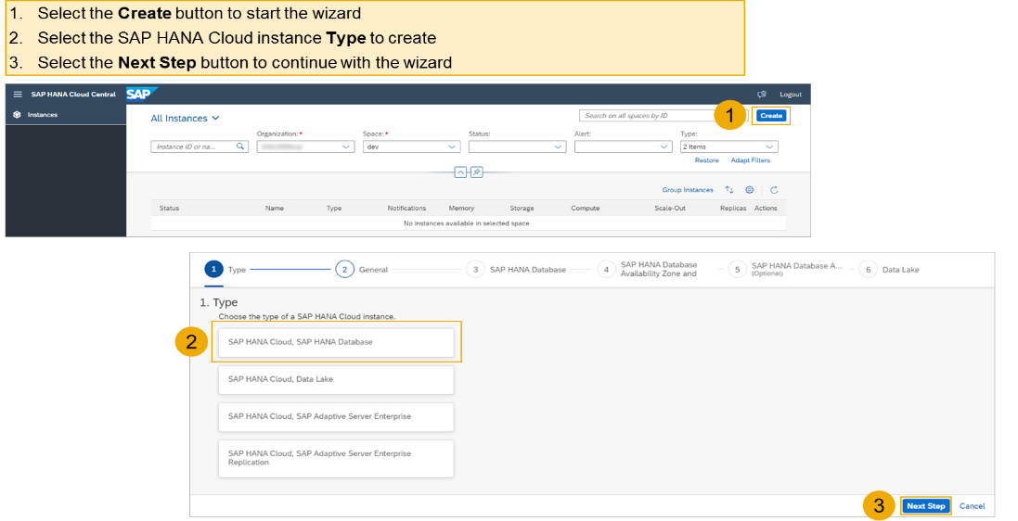
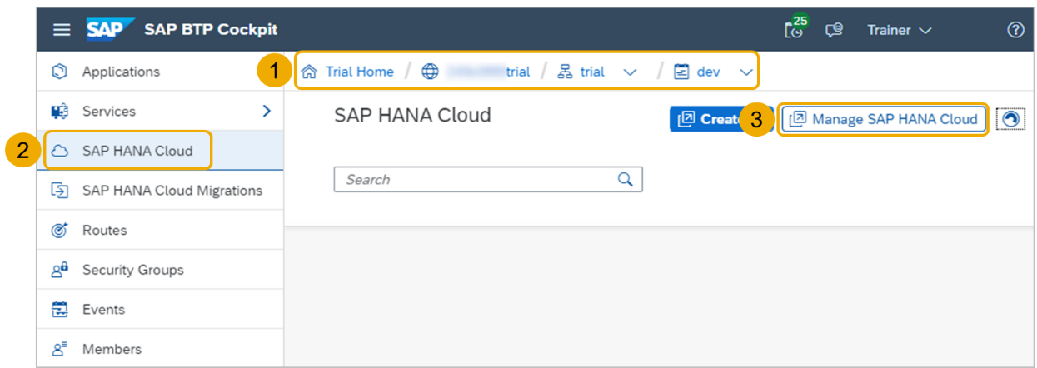
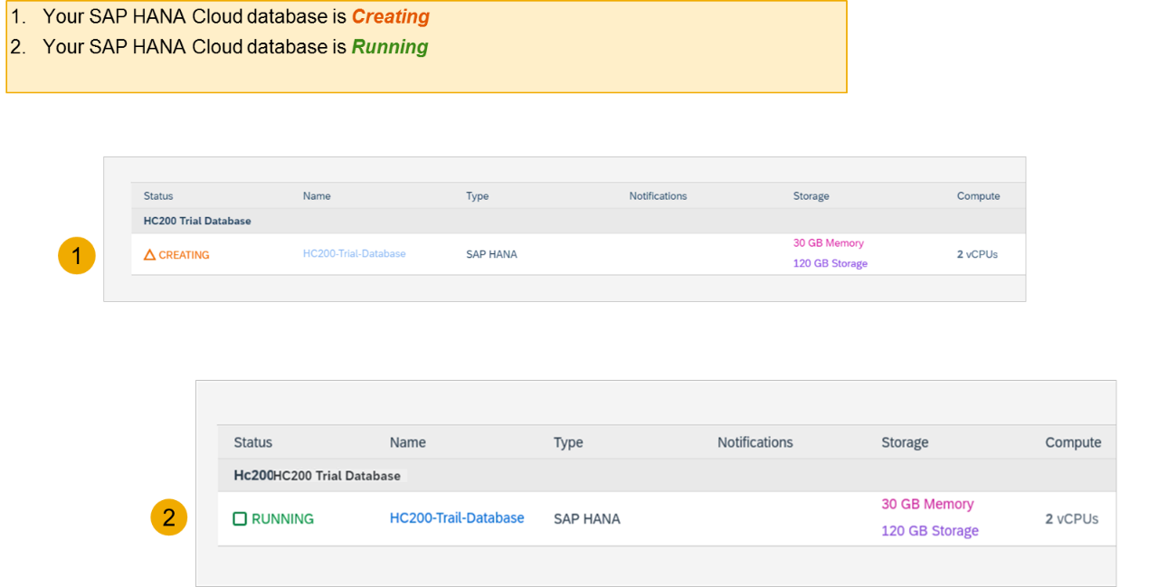
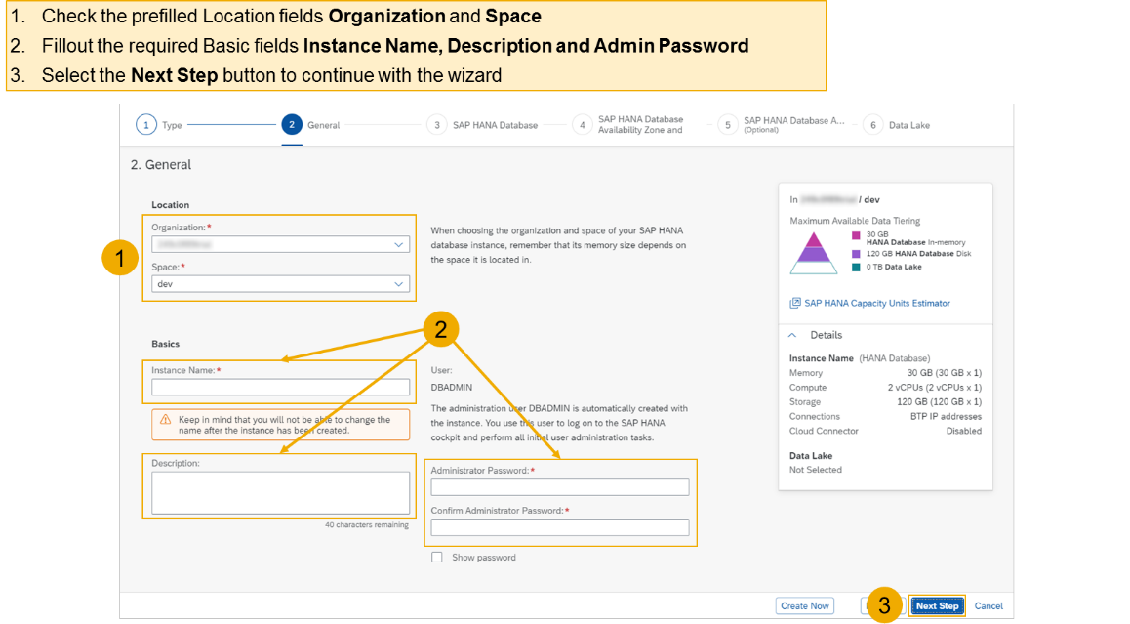
Hands on - Create HANA Cloud Instance
Login to your trial and navigate to your dev space
Select SAP HANA Cloud
Select the Manage SAP HANA Cloud button to start the SAP HANA Cloud Central
Select the Create button to start the wizard
Select the SAP HANA Cloud instance Type to create
Select the Next Step button to continue

Slide 44
Hands on – HANA Cloud Integration
Pre-requisites
Check the version of CDS (which must be > 2.0) cds –v
Start a HANA cloud instance in SAP BTP
Main steps
Add hana configuration to our app, which tell cap framework that the default db is now hana – cds add hana
2. Add the hana specific deployment format name to our project under cds section as below inside package.json file "hana":{
"deploy-format":"hdbtable"
}
3. Since the first step added the hdb node module, we need to install it. Run npm install
4. We need to perform a build, which will create all the hana specific files which will be deployed to HANA cloud. cds build --production
5. We need to login to cloud foundry from BAS – cf login
6. Finally we need to deploy the DB and everything to SAP HANA Cloud – cds deploy --to hana:batman
7. We fixed issues related to excel format of HANA and changed the size of field bankid for employee, redo the build and deploy
8. If deployment worked, a new file cdsrc-private.json gets created automatically, this file contain the information about which container in SAP BTP HANA Cloud to connect to. And the private key is stored in this file.
9. Provide the credentials which will be used to connect database, start using cds watch --profile hybrid
"credentials": {
"database": "batman-key"
}

Slide 45





















Slide 46
Authentication v/s Authorization
Authentication – It ensures that is our user a valid user? Has he/she entered valid credentials to login to our app. It is enforced by a login screen. This login screen can also come from IDP like SSO, LDAP, Social integration.
Authorization – Once user is authentication, then the authorization comes into play. It ensures, is our user allowed to do certain activities inside app. What is the level of access. E.g. create, update, delete, approve, view.
SAP BTP cf environment has a special component called XSUAA –
XS – eXtended Services
UAA – User Account and Authorization
This is an in-built component inside of CF
It is responsible to control the user account and authorization
It manages our application security
In CF we use modular approach to address security
As a developer we need to decide what roles and level of security we need in our app. Example, we need to secure odata resource /Anubhav.svc
Usually we define Viewer, Editor
We need to define our scope and role templates inside a special file called xs-security.json file
XSUAA Communicates to the IDP – Identity Provider
Issues JWT (JSON web Token) to cloud foundry router which let user access the app based on permission.
Scope
(Role)
* *
Role Template
* *
Role Collection

Slide 47

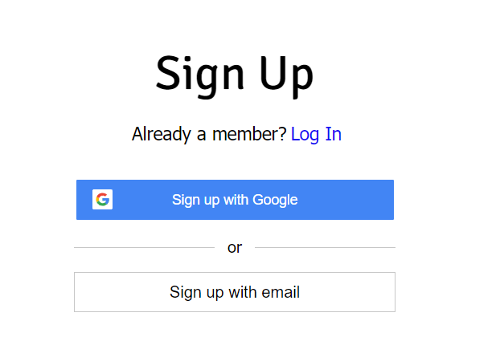

IDP – Identity Provider
An identity provider is a software or group of software which stores all the user credentials and their scopes (roles) in itself. This will centralize the user management in company and simplify the login process to different apps. This way user do not need to remember multiple passwords to multiple apps.
Portal
Launchpad
Dedicated SRM
SSO
SAP Server
G-Suite
LDAP
User/email/password
Single source of truth
Trust relation
Scope- clerk, manager, ceo
Outlook
Our cloud app
xsuaa
XSUAA

Slide 48
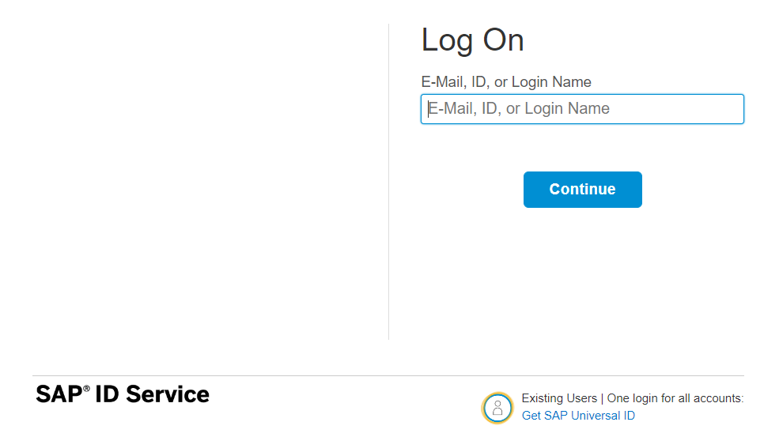
How it works behind scenes
xs-security.json contains information which we need to register to define what are all permissions required in our app
code
JWT
App
Browser
postman
Our xsuaa
trust
JWT
XSUAA
Scope
SAML
trust
IdP

Slide 49

Hands-on Add Security and Test Microservice
Exercise:
https://github.com/soyuztechnologies/SAP_BTP_Training_8Hr_Per_Day/blob/master/Day%204/Add%20mandatory%20security.txt

Slide 50
Testing the Microservice from postman
After the deployment, we open the postman tool and try to access resource with URL /vendor url, it gives unauthenticated.
We need to obtain access token so we went to authorization table and added the OAuth2.0 option and provided
Properties | Value
Token Name | BTPJWTToken
Grant Type | Password credentials
Access Token URL | Service key of xsuaa – url, append /oauth/token
Client Id | Service key – client_id
Client Secret | Service key – client_secret
Username | Our BTP account user id
Password | Our BTP account password
3. Call get token and choose use token button once token was fetched.
4. Again make get request for /vendor, and we should get response.
5. If we try /vendor/, it will not work because, we are looking for Role.
6. Went to BTP subaccount and created a Role collection, added the role template and assign same to our user
7. Again get the token and try to access end point for OData, this time it works.

Slide 51
Challenges in Current Approach
Did you notice, that we need to first pass lots of technical details from service key
Pass all the info in correct manner to postman to obtain token
Once the token expired, we need to reobtain again and again
Our end user do not know all this. Automate the XSUAA JWT token processing.
In our app, we will have multiple microservices, like java, sap ui5, node app, xsuaa…
Each service produce one end point e.g. /vendors, /index.html, /customers, they all logically belongs to same app. Will you give 3 url to our user to access these apps?
These microservices also needs to communicate with each other. Provided we give a single end point to access our entire app to end user.
We want to complete redirect mechanism to let user go to login screen, authenticate on IDP and exchange of all the tokens should be seamless behind the scenes.
We need a single entry point for entire app, forwardAuth tokens should be done automatic.
url
Application router
(Provide single entry point, exchange auth token,
Communicate between microservices, like a facade)
xsuaa
Java
/Anubhav.svc
UI5 App
/index.html
Node
/customer

Slide 52
Introduction to App Router
It is a Node JS Application
It is used to automate the process of authentication, authorization with XSUAA to do token exchange
It sits in the middle of IDP and XSUAA, it will redirect the request to our microservice to xsuaa, and eventually to idp
IDP sends the login screen to the user, user authenticates, which is taken to XSUAA, XSUAA issues JWT Token, this JWT token is presented to api end points
App Router takes the JWT token from XSUAA and gives it to our microservices and even exchange this token to multiple microservices inside
It Serves as a single entry point for the entire app.
To tell app router about our multiple microservices so that it can re-direct, we need to create a configuration file named as xs-app.json which contains the details.

Slide 53














































Slide 54



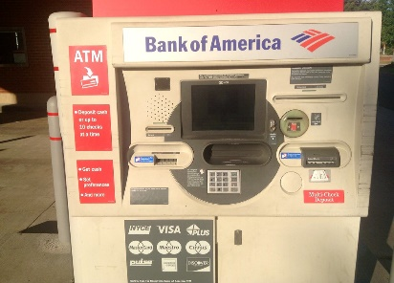
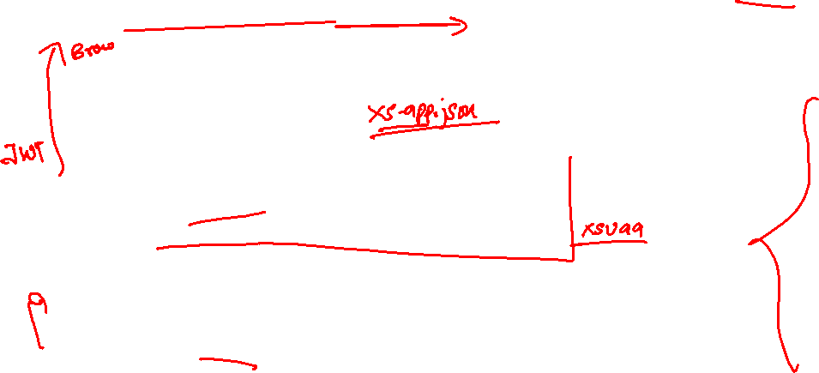
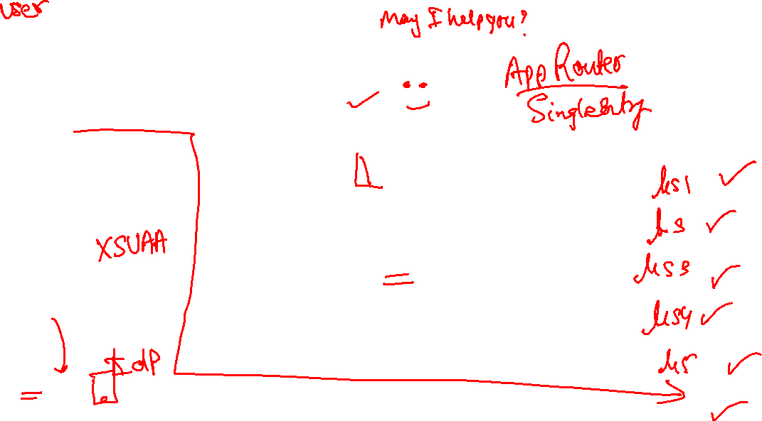
Real World Example
Customer
1
5
4
2
Loan
Credit Card
6
Validate, trust
Deposit
Draft/Cheque
3
FD
*******
7
Locker
This Photo by Unknown Author is licensed under CC BY

Slide 55
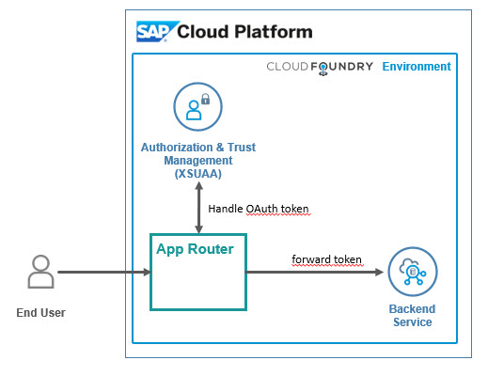
Hands on: App Router
Solution:
https://github.com/soyuztechnologies/SAP_BTP_Training_8Hr_Per_Day/blob/master/Day%204/mycapapp/app/xs-app.json

Slide 56
Hands on : Deploy Application to BTP
First add the mta.yaml file, MTA – multi-target application which is an advance version of manifest.yml file which we used in past.
We use SAP provided CLI for MTA, this is pre-installed in BAS, tool is called mbt
First we run command cds add mta
We will add our UI module to the mta.yaml file manually, copy the srv entry and add the ui module.
- name: mycapapp-ui
type: nodejs
path: app
parameters:
buildpack: nodejs_buildpack
build-parameters:
builder: npm-ci
requires:
- name: srv-api
Inside the app folder, add the package json using npm init and add the app router module npm install @sap/approuter.
Add the start script "start": "node node_modules/@sap/approuter/approuter.js"
Add the xs-app.json, provide the routes and the end points
Open MTA editor and configure srv-api destination
Right click on mta.yaml file and choose build mta archieve this will create a mtar file for us

Slide 57
Adapt MTA.yml for UI deployment
Exercise:
https://github.com/soyuztechnologies/SAP_BTP_Training_8Hr_Per_Day/blob/master/Day%204/mycapapp/mta.yaml

Slide 58
Hands on – Adding Security
Created a new resource in mta.yaml file for xs-uaa backing service with following properties
name == cappo-xsuaa
service == xsuaa
service-plan == application
path == ./xs-security.json
Add the dependency of this newly created xs-uaa service to our microservices in require section
Create the xs-security.json file from sap btp documentation and adapt file to have 2 roles – Viewer and the Admin role. The viewer role also have an attribute called bank name which will be for row level security.
Add 3 node modules which will help in security configuration for our app
npm install passport ; npm install @sap/xssec ; npm install @sap/xsenv
5. We need to inform app router to contact xsuaa to mandate the use of JWT token. In xs-app.json file
Change authenticationMethod : route and add "authenticationType": "xsuaa"
6. We need to secure our service resources to only allow authenticated user, hence we need to add an annotation requires: 'authenticated-user’
We need to tell system that if we run app locally (development environment) in BAS tool, use mock strategy for testing security. After deployment to CF (production environment) we use JWT strategy.

Slide 59
Security Profile
Additionally we configure demo local users for testing purpose. Under cds → requires section inside package.json file we add the strategy
"auth":{
"[production]":{
"strategy": "JWT"
},
"[development]":{
"strategy": "mock",
"users": {
}
}
}
8. Now we can test our app using cds watch --profile hybrid

Slide 60

What We Did
Let’s Summarize

Slide 61

www.anubhavtrainings.com
Thank You
End of Day 1

Slide 62



We’re committed to empower you to be
#FutureReady
through powerful training solutions.
We build the workforce of the future.
250+
Corporate Clients
30,000+
Learners Trained
25000+
Learners Placed
FREE WEBINARS
Sign up for free webinars with industry experts every fortnight!
Enroll Now!
Contact us today!
https://anubhavtrainings.com

